Slide 1




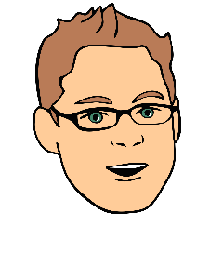



One Bridge - from Business to Technology
The only place you need to go for turning ideas or problems into future possibilities.
Idea or Problem Home
Review & Collaborate

